Slide 1
Secured Distributed Multi-Agent Role Based Access Control
Fawaz Alsaadi
Fahad Alsolmai

Slide 2
Introduction
Role Based Multi-Agent System for providing effective and secure Bank transaction services
To provide seamless access to information present in the database
Negotiation agent to access and trust negotiations, Database agent
Interface Agent to accept and display request service results.

Slide 3
Introduction
Main Features of the system
Ease of use,
Effective communication between customers and service providers,
Isolation from resource specific details, changes in the system and internal complexity

Slide 4
Introduction
Agents developed using Java Agent
Development Framework (JADE)
Java APIs
System provides features such as
The Login Validation or User Authentication
Service Registration,
Role Agent Identification, and
User Interface for an effective interaction between customer and the system.
The role agent retrieves the information from database and sends it to the customer through an interface agent.

Slide 5
Survey of related works
Aurora Vizcanaino et al [1] proposed a multi-agent model which is suitable for developing a generalized knowledge management system
C.VGoldman et.al
Suggested a decentralized collaborative multi-agent communication model and mechanism design based on Markov Decision Process (MDP)
Assumed that agents are full-synchronized when they start operating
No specific optimal algorithm is presented
No experimental results showing their algorithm can work on large team

Slide 6
Survey of related works
Fabio Belliemine presented a framework for team coordination under incomplete information based on the incomplete information game theory that agents can learn and share their estimates with each other.
Uses a probability method to coordinate agent team without explicit communication by observing teammates’ action and coordinating their activities via individual and group plan inference

Slide 7
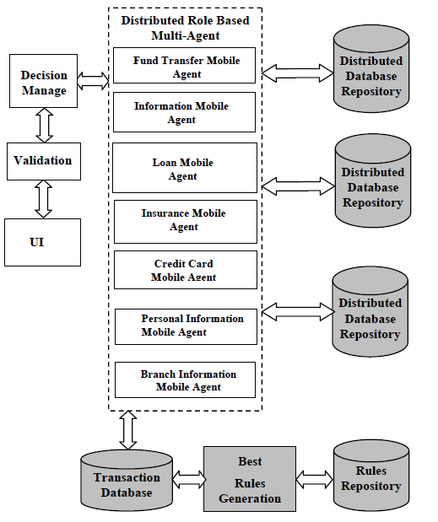
System Architecture
System accepts the customer request by interface agent.
The facilitator is used to register the service of role agents.
The role agent has the ability to forward the request to negotiator for the validation of request and account details.

Slide 8
System Architecture
The database agent possesses the capacity to retrieve the customer information.
The interface agent is used to display the customer details.

Slide 9
System Architecture
User Interface
Graphical User Interface
Mobile Agent Creation module
Server with appropriate resource is identified to process the customer request.
Facilitator coordinates the mobile agent to process customer request.
Facilitator registers the agent to access a particular service using its Agent ID.
After completion of the customer service the facilitator deregisters the service.

Slide 10
System Architecture
Loan Mobile Agent
System lists the available bank loan schemes to the customer
Checks the customer’s history
If the customer has sufficient balance, the loan is sanctioned
New loan is not entitled unless the customer pays the previous dues.
The customer balance amount gets updated when permitted to avail the loan.

Slide 11
System Architecture
Credit Card Agent
Provides access rights to the customer
Sends the customer information to interface agent.
Interface agent coordinates the Credit Card Agent to register its service with the facilitator.
Role of the agent is to process the customer request.
The role based agent checks the customer’s earlier due regarding cash or purchase.
If customer do not have due then the customer is permitted to use the credit card within the permitted limit.
If the customer has dues, credit card payment is barred

Slide 12
System Architecture
Insurance agent
Provides information to all customers about the insurance offers (i.e. access to polices, brochures and price list).
Describes the characteristics of different types of insurance and their attributes.

Slide 13
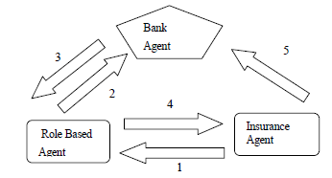
System Architecture
Payment of Insurance bill
1 Electronic bill generation
2. Payment order
3. Electronic notification for sufficient money
4. Electronic notification to Insurance agent
5. Verification of money transfer

Slide 14
System Architecture
Decision Agent
Makes the decision from the role based multiagents with the coordination of a data warehouse.
Multi-Agent Communication
To achieve the individual objectives or dynamically coordinate the actions, software agents need to interact with one another.
Communication is at the basis of agents interactions

Slide 15
System Architecture
Foundation for Intelligent Physical Agent (FIPA)
Specifies standard components that can be used
Determination of valid sequences of messages called INteraction Protocols (INP) regulating specific interactions to be known by all the interacting entities

Slide 16
System Architecture
Foundation for Intelligent Physical Agent (FIPA)
Agent Communication Language (ACL)
Enables the attitudes regarding the content of exchange to be expressed.
e.g. whether the content of the communication is, an assertion, a request or some form of query
Two most deployed ACL: FIPA-ACL and Knowledge Query Manipulation Language (KQML).

Slide 17
System Architecture
Foundation for Intelligent Physical Agent (FIPA)
FIPA-SL, Knowledge Interchange Format (KIF) content Languages (CLs) used for describing the content of the message
At the ontology level, a vocabulary and a set of agreed definitions is used to describe a specific domain in terms of objects, actions and functions

Slide 18
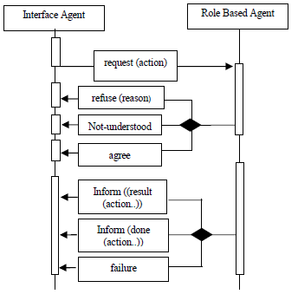
System Architecture
Interaction Protocols for Agents Conversations
Typical patterns of message exchange
Represent the highest abstraction component in the Agent Communication Stack
Standard fipa-request protocol is used when the Interface agent contacts the Role Based Agent for requesting the information of customer account
Identifies the specifickind of ACL messages which the agents are expected to exchangeas shown in Figure.
The standard FIPA-request interaction protocol

Slide 19
Experimentation and Results
System was implemented with JADE 3.3, Java and Oracle 10g.
Java uses its database driver called JDBC (Java Database Connectivity) to connect the database.
The interface between Oracle and Java is provided by JDBC-ODBC protocol.
Bank application was implemented with Multi-Agent Role Based Access Control in distributed environment.
Processing time consumed was very less with respect to the number of transactions as compared to client server systems.
User can launch the agent in two ways:
GUI agent Wizard,
Via command line.

Slide 20
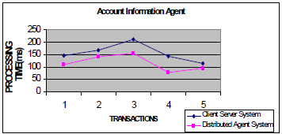
Results
Account Information Agent
Role based multi-agent GUI is created using JADE and Swing.
The Account information agent gets the username through the interface agent.
Role of agent is registered with facilitator.
Now the user details are negotiated based on the behavior of the agent.
Based on the agreement the account number and customer account balance from the account table and branch name from the branch table are joined before displaying the information.
Results show that processing time is much less than for client server system.

Slide 21
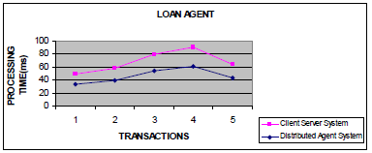
Results
Account Information Agent
Authentication is checked
Lists the available bank loan schemes to the customers.
The user can select the options.
Before sanctioning the loan to the customer, this checks the customer dues.
The customer information is negotiated and if the customer has sufficient balance, the loan is sanctioned.
New loan is not entitled unless the previous dues are paid.
The customer balance is updated when permitted to avail the loan.
Results show that processing time is much less than for client server system.

Slide 22
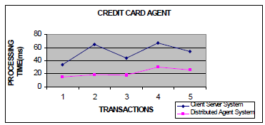
Results
Credit Card Agent
Credit card agent sends the customer information to interface agent.
Interface agent coordinates to register its service with the facilitator.
Role based agent checks the customer history.
If customer does not have any due the usage of credit card is permitted to a limit.
Results show that processing time is much less than that for client server system.

Slide 23
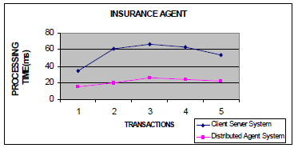
Results
Insurance Agent
GUI displays the available Insurance details with coverage options.
Various scenarios are implemented with the purpose of evaluating the feasibility and the effectiveness of automated agent-based transactions.
Results show that processing time is much less than for client server system.

Slide 24
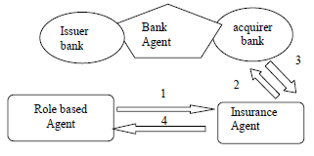
Results
Insurance Agent
Intra-Bank payment order
The insurance amount is deducted from the buyer’s account and credited to the seller’s account.
If the buyer doesn’t have sufficient balance, it can be informed.

Slide 25
Results
Insurance Agent
Inter-Bank payment order
Role based agent specifies an insurance policy with Insurance service provider agent X for $3000.
Y’s Role Based Agent orders the bank to transfer $3000 from its bank account to the Insurance provider agent – X‘s account.
In such a condition, the insurance provider account is managed by adifferent bank agent.

Slide 26
Results
Insurance Agent
Credit Card Based Payment Scenario
Role based agent stipulates an insurance policy with insurance provider agent for $3000.
Role based agent pays the specified amount of money via customer’s credit card account.

Slide 27
Results
Rules Generator Agent
In the Rules Generating Agent module, the completed processes are stored in the transaction database.
The frequent Role based mobile agent sets are identified by using support and confidence.
After obtaining the Role based agent sets it can be associated with other Role based Agents for making the knowledge.
The best Rules are generated based on the given input transaction dataset values,

Slide 28
Conclusion and Future Work
System architecture for Distributed Role Based Multi-Agent System was proposed.
This system is implemented with Banking Domain application
Accepts the user request,
Identifies the role and
Agent Facilitator creates the role base mobile agent, transmission of secured agent data and adopts the customer needs to provide the desired results.

Slide 29
Conclusion and Future Work
The Boolean Association rules are implemented to generate knowledge from frequent Role Based Multi-Agent System.
It can be enhanced to implement Quantitative Association Rule to associate role based multi-agents to get more dependency of Distributed role based Agent

Slide 30
Thank You

