Slide 1
Content Oriented Virtual Domains for Secure Information Sharing Across Organizations
Fawaz Alsaadi
Fahad Alsolmai

Slide 2
INTRODUCTION
Secure information sharing across different organizations is an emerging issue for collaborative software development, product design.
The external threats are taken care of by using firewalls and mail filtering appliances.
For cross organizational security virtual domain is proposed.
Virtual domain collaborative workspace comprising virtual computer with resources dedicated to a particular collaborative activity.

Slide 3
INTRODUCTION
Domain virtualization using Content Oriented Virtual Domains (CoVD):
CoVD collection of computer resources that are connected via common services.
Allow leveraging existing common services from authorized resources.
Allows content-based policy enforcement such as encryption onto mails going through common mail services, and contents filtering for files shared in common file services

Slide 4
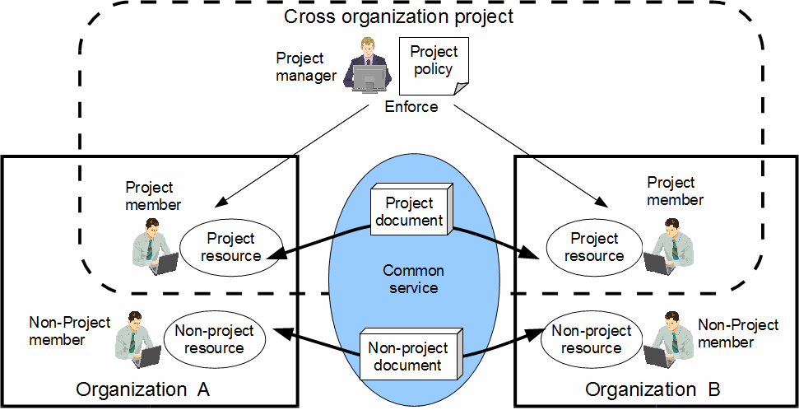
Cross organization project
Organizations A and B have are collaborating on a software development project.
A project manager responsible for project management
including its information security.
Project members create documents for the project and share these documents using common services

Slide 5
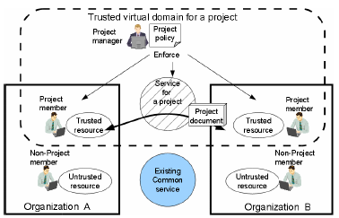
Trusted Virtual Domain based Workspace Model
TVD can be constructed as a cross organization workspace of the project by virtualizing every resource dedicated to a particular project.
Project manager can enforce given policies to all trusted resources in individual TVD.
Allows project members to securely share project specific information even through the common services
In this model all common services dedicated to a project need to be newly constructed apart from existing services. This require additional cost even if the resources are virtual.

Slide 6
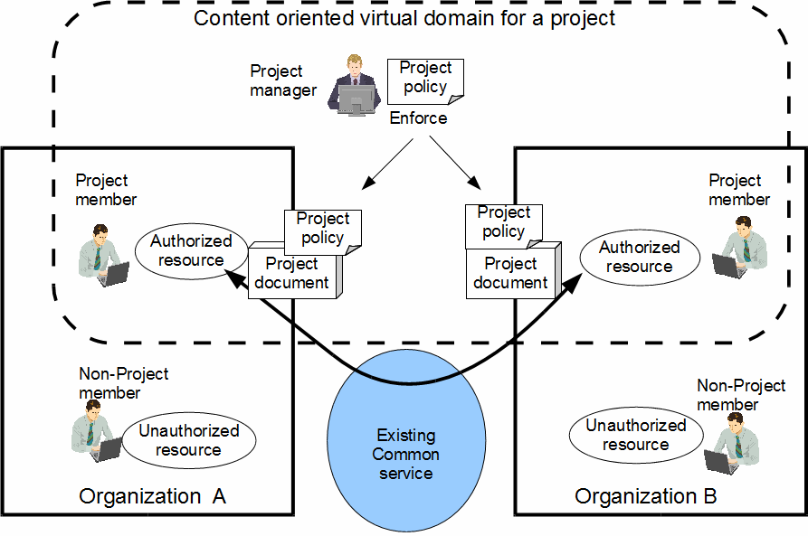
CoVD Based Workspace Model
In CoVD workspace comprises project members, authorized resources used by the members.
Existing common services can be leveraged without any modification.
CoVD model requires no additional costs for the common services

Slide 7
CoVD Based Workspace Model
To make secure information sharing through the existing services, the policy is enforced not to the authorized resources, but to the project documents shared in common services.

Slide 8
CoVD Based Workspace Model
Example of email:
A project member of organization A writes an e-mail attached with a specification document to his or her co-worker of organization B.
CoVD automatically encrypts the email with a project-specific shared key accordingly to the policies given by a project manager.
Because the project key is shared within the authorized resources of the CoVD, the specification documents are accessible by only the project members, even if the e-mail goes through the existing mail servers.
With this content based policy enforcement, the CoVD achieves secure information sharing through the exist.ing common services

Slide 9
CoVD ARCHITECTURE
Requirements
Domain management
Member management required for specifying the project members.
Resource management is required for constructing and authenticating virtual resources used in the member environment.
Policy management is required for specifying and distributing the project information sharing policies to the member environments.
Member environment in the workspace
Resource virtualization is required for creating the project specific resources at low cost.
Member authentication for allowing only the project members to use the virtual resources.
Resource authorization for quarantine.
The information sharing policy must be enforced on the project documents

Slide 10
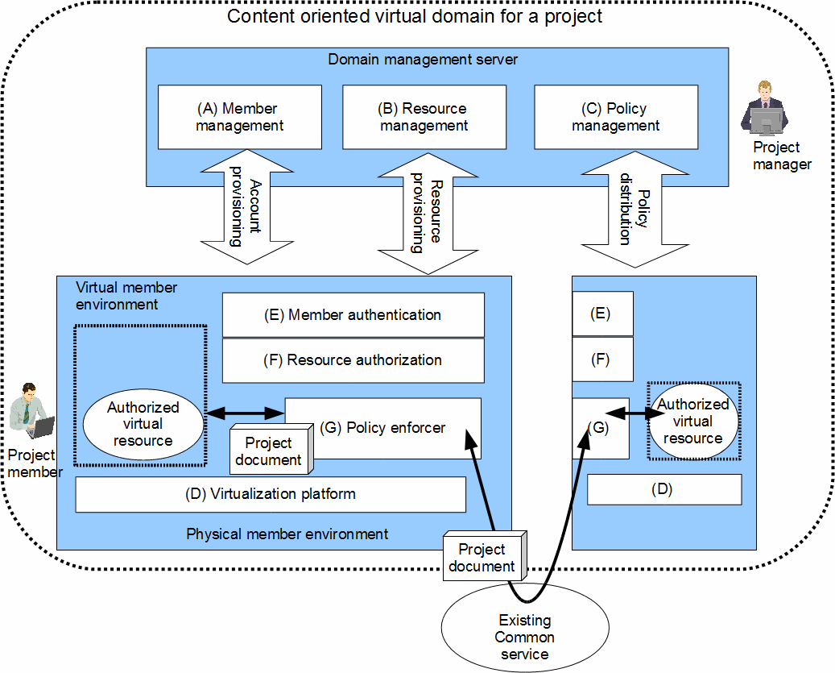
CoVD ARCHITECTURE Overview
Domain management server has
Member management component (A),
Resource management component (B),
Policy management component (C)

Slide 11
CoVD ARCHITECTURE Overview
Domain management
Component (A)
Used for registration of member accounts
Component (B)
Use for construction of original images of virtual resources.
Component (C)
Use for specifying of the information sharing policies for the project, and distributes them to the enforcers.

Slide 12
CoVD ARCHITECTURE Overview
Member environment in the workspace.
Each physical member environment uses a
virtualization platform (D)
Uses a member authentication component (E)
Resource authorization component (F),
Policy enforcer (G)

Slide 13
CoVD ARCHITECTURE Overview
Member environment
virtualization platform (D)
Receives a copy of the virtual resource image and creates the virtual resources for constructing a virtual member environment.
Member authentication component (E)
Authenticates the members with the accounts provisioned by the member management component or mediates an authentication protocol to the existing authentication server

Slide 14
CoVD ARCHITECTURE Overview
Member environment
Resource authorization component (F)
Checks the signature of the authorized virtual resources to confirm whether the structure of the resources is as defined by the manager.
Policy enforcer (G)
Monitors network communications
Enforces the policy on the exchanged documents

Slide 15
IMPLEMENTATION
Feasibility of the cross organizational policy enforcement was evaluated by implementing 2 core components of the CoVD architecture:
Policy management component to specify policies, and
Policy enforcers to control network data according to the policies
Widely available implementations used for other components such as:
Member management component: Microsoft Active Directory
Resource authentication component: TPM/TCG software stack
Virtualization platforms: Xen, VMWare, and Hyper-V

Slide 16
Policy management component
Allows the project manager to specify policies & consists of:
Policy editor: Allows to specify policies
A cgi to provide a web interface
Policy repository to store the specified policies
directory to store policies
Policy deployer distributes the policies to the policy enforcers on each client
web server that publishes the directory to the policy enforcer

Slide 17
Policy enforcer
Retrieves the policies using an HTTP protocol.
Deployed in the management environment which is separated from the virtual member environment.
Xen is used
Policy enforcer in the deployed in Dom0 corresponding to the management environment.

Slide 18
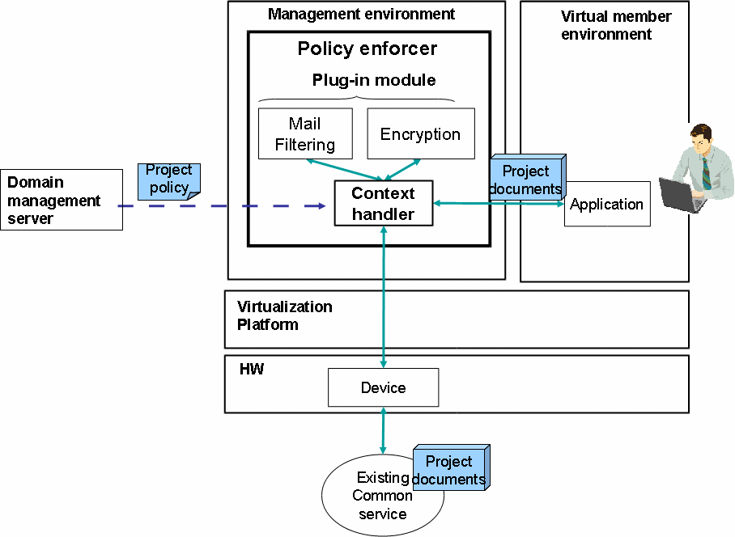
Policy enforcer
Extensible structure designed to allow expansion of the policy expression capability by adding a plug-in module
Dom0, policy enforcer comprises of
context handler,
condition plug-in modules
obligation plug-in modules

Slide 19
Policy enforcer
Context handler
Policy interpreter
Hooks IP packets
Calls the condition plug-in modules
condition plug-in module
Performs filtering according to the condition
Obligation plug-in modules according
performs required content transformation to the policies

Slide 20
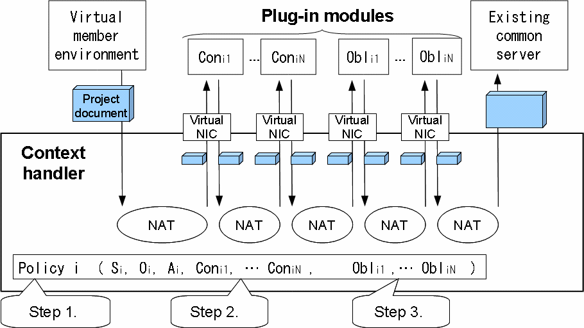
Policy enforcer
Context handler
Monitors all network communication so that it enforces policies without fail.
Context handler implemented as a bridge driver that connects DomU and network interface card.

Slide 21
Policy enforcer
Context handler policy enforcement
Finds an appropriate policy by identifying the IP address and port number of IP packets
Context handler interprets the policy and calls condition plug-in modules and obligation plug-in modules
To call the plug-in modules, the context handler performs a Network Address Translation (NAT)
Each plug-in module has a virtual NIC and opens sockets on its virtual NIC.
Context handler hooks IP packets to/from the DomU and performs the NAT so that the network connection goes thorough plug-in modules

Slide 22
Policy enforcer
Context handler performs the NAT according to the policy
Step 1 (find out the policy)
Monitors the IP packets and identifies the source/destination IP address and the source/destination port number.
Context handler finds the policy according to the IP addresses and port numbers.
If the IP addresses and the port numbers do not match any policies, the context handler drops the packet.

Slide 23
Policy enforcer
Context handler performs the NAT according to the policy
Step 2 (call condition functions)
Context handler refers to the first condition plug-in module’s IP address.
Context handler changes the destination IP address into the first module's IP address.
Context handler hooks the packets from the first module
Context handler transfers the packets to the next module.
In the same way, the context handler repeats the NAT till the last condition module.

Slide 24
Policy enforcer
Context handler performs the NAT according to the policy
Step 3 (call obligation functions)
The context handler transfers the packets to obligation plug-in modules.
If the context handler hooks a packet from the last obligation module, the context handler changes the destination IP address into the server’s IP address.

Slide 25
Performance Evaluation
Use case where there is an existing mail server
Project members share project documents using this server.
Used Thunderbird as the mailer and Postfix as the server.

Slide 26
Performance Evaluation
Secure mail exchange
Assumed that project members should send mail only to other project members to prevent information leakage.
Mail is encrypted to prevent eavesdropping.
Used following policy for secure mail exchange:
RecipientCheck (MailEncryption(*:*,,192.168.0.3:25) )

Slide 27
Performance Evaluation
Secure mail exchange
Project member sends a mail,
Recipient check module analyzes the SMTP protocol and identifies recipients.
Checks to see if the recipient is allowed using the allowable recipient list.
If the recipient is allowed, the module mediates the mail. Otherwise, the module drops the mail and closes the network connection to the server.
Mail encryption module also analyzes the SMTP protocol and identifies the mail body.
It encrypts the mail body using the project key

Slide 28
Efficiency Evaluation
Efficiency of the context handler and the modules were measured using the time to download a file using a WebDAV client (cadaver version 0.23.0 with neon version 0.27.2)
Used two machines Pentium D 3.4GHz CPU, 3 GB memory with onboard Intel e1000 NIC.
The two were connected via a 100 Mbps hub,
One machine was used for a server, and the other was used for a client.
Downloaded files of different sizes (1 MB, 10 MB, 50 MB, 100 MB) and measured the download time in 2 cases
Used an unmodified Xen bridge driver in case (a)
In (b) case a context handler and a plug-in module with the plug-in interface was deployed
The module was implemented using Perl, and it had a dummy security function

Slide 29
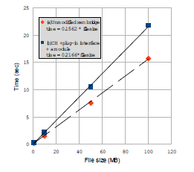
Efficiency Evaluation
The download time is proportional to file size
The overhead of case (b) is almost constant regardless of the file size.
In case (a), the regression line is time = 0.1562 * file size,
In case (b), time = 0.2166 * file size
The overhead was calculated using
0.21 66 / 0.1562 = 1.387 (38.7%)
Using system profiler (OProfile) it was identified that the overhead was caused by network communication between the context handler and the plug-in modules

Slide 30
RELATED WORK
VPN based approach
VPN approaches focus on document sharing within a single organization, while paper’s focus was on cross organizational document sharing.
Virtualization Based Policy Enforcement
The main difference in other approaches such as TVD is that this paper’s approach leverages public service to reduce the cost.

Slide 31
CONCLUSION
Proposed a method of constructing Content Oriented Virtual Domains, which leverages existing common services and enables a secure collaborative workspace.
CoVD monitors document exchange, checks conditions, and enforces obligations according to project policies.
Implemented the policy management component and the policy enforcer, which can expand policy description capability by addinga plug-in module.
Performance evaluation showed that CoVD allows shareing the project documents safely using existing services such as e-mail.

Slide 32
Thank You

