Slide 1
Secure Smart Grid
Edward Chow
Department of Computer Science
University of Colorado at Colorado Springs

Slide 2
What is Smart Grid?
automated, widely distributed energy delivery network
characterized by a two-way flow of electricity and information,
capable of monitoring/responding to changes in power plants, customer preferences individual appliances.
Enable new opportunities and support innovations:
  nationwide use of plug-in hybrid electric vehicles,
  ability to return stored energy to the grid;
  seamless integration of renewable energy sources like wind and solar;
  enabling consumer choice;
  integration of green building practices with the grid;
  Large-scale energy storage

Slide 3
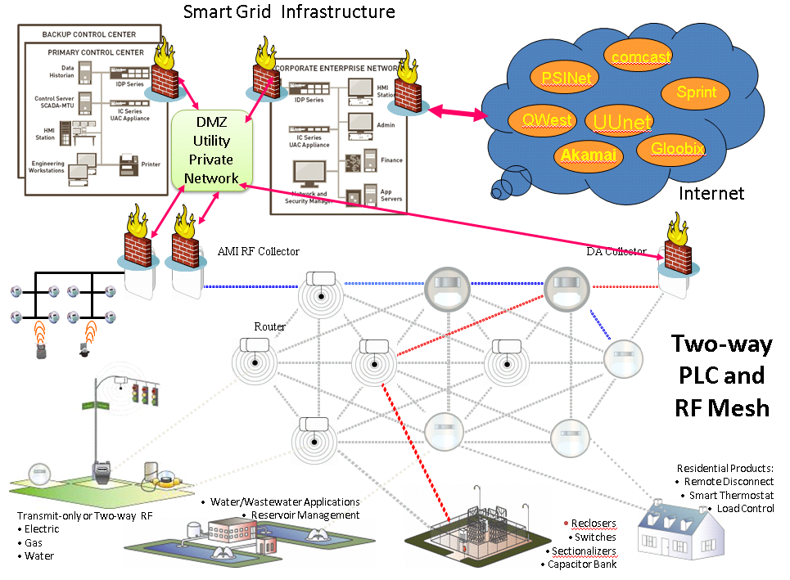
Local Smart Grid Security
Botnet DDoS Attacks
Insider Attacks
Meter Database
Tampering
Snooping
Jamming
Worm Hole Attacks
Fake ID
Hijack Station
Electric/Hybrid
car charging station
Device
Tampering
substation

Slide 4
Trans-Smart Grid Security
Inter-operabilities:
  Key Management Systems/KMIP
Coordinated Intrusion detection and handling (DDoS attacks)
Coordinated disaster recovery and outage management
Protect security access to systems providing new smart grid services/feature
  proposed energy storage system
  Hybrid/electric charging station (Mutual authentication; authentication of keys issued by different utilities/vendors)

Slide 5
Secure Smart Grid Challenges
Utilization of Internet and related IP and wireless technologies→ expose the system to easy, remote, extern cyber threats such as DDoS attacks from North Korea.
immense areas to be monitored and physically secured.
infrastructure security and cyber security need to be addressed.
Threats can come from hostile governments, terrorist groups, disgruntled employees, malicious intruders, complexities, accidents, natural disasters as well as malicious or accidental actions by insiders.

Slide 6
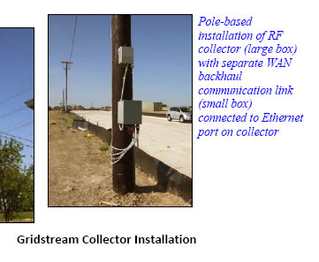
What is wrong with this picture?
Real picture from a SG vendor's brochure:-)

Slide 7
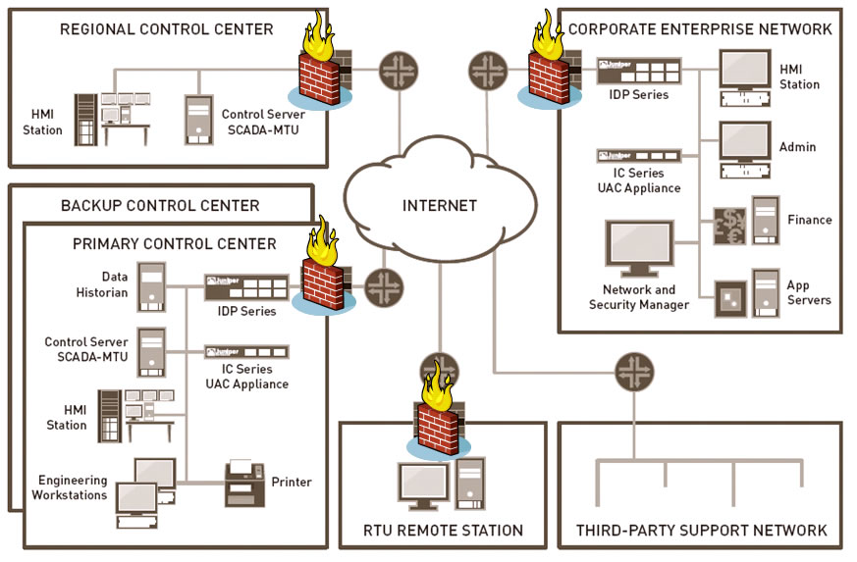
What is wrong with this diagram?

Slide 8
RMSSGI Security Program
Mission:
“Improve the security of national smart grid infrastructure and impact future security standards for smart grids through coordinated large scale multi-utilities demo projects.”
Program Team Members:
  Dr. Edward Chow (Cyber Security) Project Co-Lead
  Dr. Ray Tretcher (Infrastructure Security) Co-Lead.
  23 Researchers from MIT Lincoln Lab, Sandia, UCB, UCCS, CSU, DHS, LM, Bell Lab, CS Utilities, Northcom, Merrick, NISSSC
See web site: http://athena.uccs.edu/ssg/

Slide 9
SSG Program Concepts
Ensure ability to ensure the three basic security service availability, integrity, and confidentiality (CIA) of smart grids.
Incorporate the new physical/cyber security technologies and best practices in security → guarantee the uninterrupted service delivery even under DDoS or malicious worm attacks,
Monitor, locate, isolate, and respond to physical attacks,
Ensure the integrity of the operation and data collection,
Protect the privacy of its customers/employees and the confidentiality of the system data and programs.

Slide 10
Program Concepts/Demo Projects
Cross Domain Secure Information Sharing For DDoS Defense and Coordinated Disaster Recovery
Key Management and Distribution
Secure Collective Smart Grid Defense
Secure SCADA and Efficient Multi End Point Security
Biotope based Biometric Authentication Infrastructure
Meter Data Integrity for Peak/Outage Management
Penetration Testing, Software Scanning, and Vulnerabilitiy Analysis

Slide 11
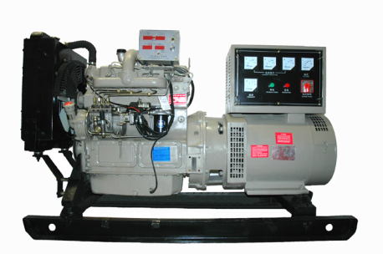
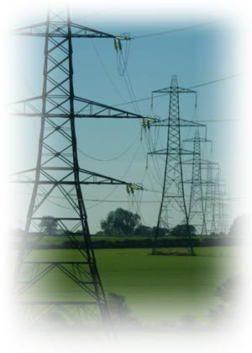
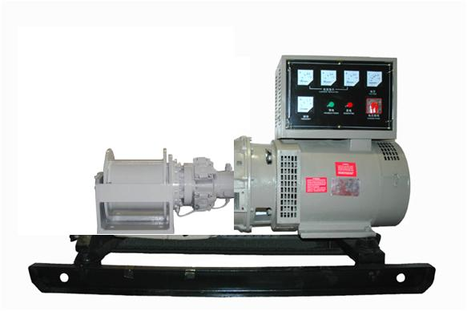
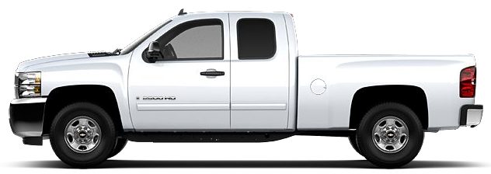
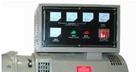
Strategic Power Deployment
Sturman‘s Digital Engine technology uses advanced closed loop controls to optimize fuel efficiency and engine power generation from clean renewable fuels to meet the demands of Utility Providers (Natural Gas) , Military (JP8 / Jet A, Diesel), and Commercial Customers (Biodiesel, Ethanol.)
Back-up power generation are equipped with the same fully flexible advanced multi-fuel engine used in vehicles
The generator is driven by the same Digital Engine that powers transportation vehicles to take advantage of high volume engine production and reduce costs
Utility vehicles can be deployed to drive stationary generators that are tied to the Smart Grid for emergency back-up power generation
(The electric generator is driven by the vehicles primary Digital Engine eliminating the need for a redundant engine at the generator site)
Deployment of mobile power generation can be connected to the Smart Grid at strategic locations
(The electric generator is driven by the vehicles primary Digital Engine)

Slide 12
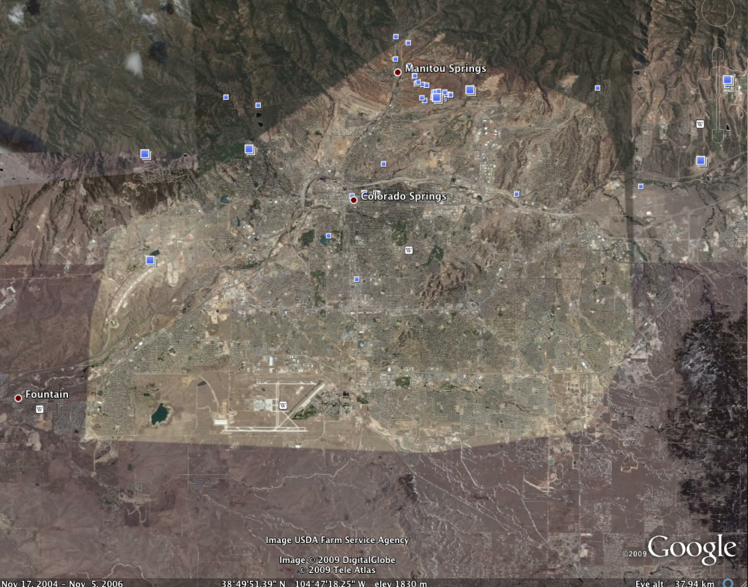
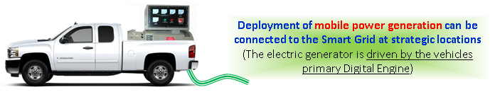


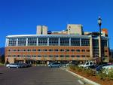

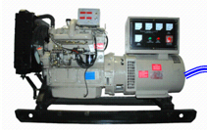
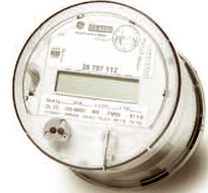
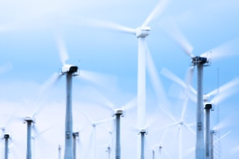
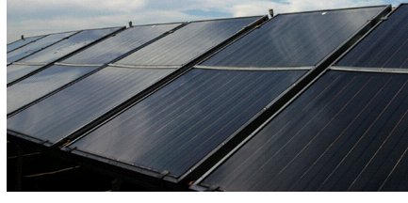
STRATPOWER-M: Strategic Power Deployment-Mobile
Disaster Recovery
Emergency Response
Hospitals
Backfeeding Colorado Springs Utilities Power Grid
UCCS Secure Smart Grid Lab
Backup power for server room
UCCS MicroGrid
Advanced Meters+Optimal Control
Renewable Energy Integration
Low carbon footprint, efficient multi- fuel backup power generation based on
Sturman’s digital engine technology

