Slide 1
Stuxnet Malware Attribution
Mike Albright
CS 591
Fall 2010

Slide 2
Stuxnet Background
3 zero-day Windows vulnerabilities leveraged
Designed to attack Programmable Logic Controllers (PLCs)
SCADA = supervisory control and data acquisition
Leveraged SIMATIC (Siemens) WinCC/Step 7 control software vulnerabilities
Changes configurations of controlled PLCs
Required specific brands of variable-frequency drives (VFD) manufactured in either Finland or Iran

Slide 3
Stuxnet Background
Exploit Code > 500KB
USB stick distribution
Receives updates from 2 command-and-control servers (since disabled)
Receives updates from peer-to-peer network
Sophisticated design, expensive to create
8 to 10 people
6 months to write/test

Slide 4
Stuxnet Distribution
Malware Distribution (by country based on WAN IP)
Iran – 60K+
Indonesia – 10K+
India – <10K
China – 6M+ (1K business IPs)
Target speculation
Iran’s nuclear program
India’s space program

Slide 5
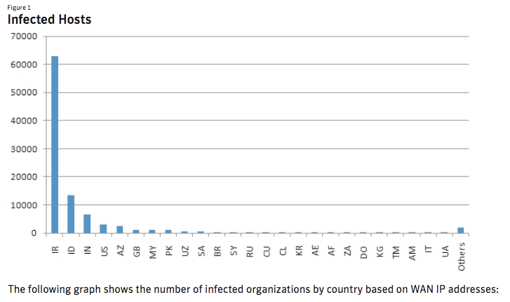
Stuxnet Infections (Symantec)

Slide 6
Stuxnet Attribution
Government?
Israel (Obvious clues within code)
U.S.
Funded organization?
Russian contractors for Iran’s nuclear program
Criminal?
Sabotage v. Extortion

Slide 7
Malware Attribution Challenges
Law enforcement entities
Demonstrate financial loss
Nuisance v. criminal activity
Private RCA
Risk of incrimination
Code source
Who ‘owns’ the botnet?
Who loaded the USB sticks?

Slide 8
Sources
Bruce Schneier Blog, 7-Oct-2010: http://www.schneier.com/blog/archives/2010/10/stuxnet.html
Symantec Stuxnet Dossier, v 1.3 (November 2010): http://www.symantec.com/content/en/us/enterprise/media/security_response/whitepapers/w32_stuxnet_dossier.pdf
Stuxnet: Fact vs. theory, CNET article, 5-Oct-2010: http://news.cnet.com/8301-27080_3-20018530-245.html
Clues emerge about genesis of Stuxnet worm, The Christian Science Monitor, 1-Oct-2010: http://www.csmonitor.com/World/terrorism-security/2010/1001/Clues-emerge-about-genesis-of-Stuxnet-worm

