Slide 1
New Computer Security Threat
- ClickJacking
Ehab Ashary
CS591-F2010
University of Colorado, Colorado Springs
Dr. C.Edward Chow

Slide 2
What is ClickJacking?
“The basic idea is that an attacker loads the content of an external site into the site you’re visiting, sets the external content to be invisible and then overlays the page you’re looking at. When you click a link you see on the current page, you are in fact clicking on the externally loaded page and about to load pretty much whatever the attacker wants .”
Ehab Ashary 12/8/2010 2

Slide 3
Why Should I care?
It is transparent
Simple to implement
Difficult to stop
No one has yet come up with an effective solution
SQL Injection
1,440,000 Google Results ~ 12 year old
Cross-Site Scripting xss
1,150,000 Google Results ~ 14 year old
ClickJacking
265,000 Google Results ~ 2 year old
Ehab Ashary 12/8/2010 3

Slide 4
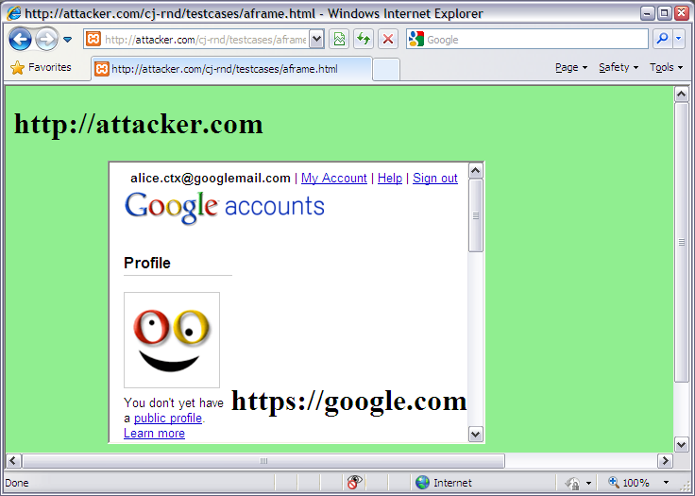
How?
It is all about iFrame.
Any site can frame any other site
<iframe src=“http://www.google.com/...”></iframe>
HTML attributes:
Style, layouting HTML element
Opacity defining the visibility percentage of the iFrame
1.0 complete visible
0.0 complete invisible
Ehab Ashary 12/8/2010 4

Slide 5
Facebook, Like or Unlike
Ehab Ashary 12/8/2010 5

Slide 6
Facebook, Like or Unlike
Ehab Ashary 12/8/2010 6

Slide 7
Facebook, Like or Unlike
Ehab Ashary 12/8/2010 7

Slide 8
Facebook, Like or Unlike
<div id="wrapper" style="position: absolute; opacity: 0.0; filter: alpha(opacity = 0); margin-left: -50px; z-index: 5;">
<iframe src="http://www.facebook.com/plugins/like.php?href=http://www.victoriassecret.com/&amp;layout=button_count&amp;show_faces=false&amp;width=50&amp;action=like&amp;colorscheme=light&amp;height=21" scrolling="no" frameborder="0" style="border:none; overflow:hidden; width:50px; height:21px;" allowTransparency="true"></iframe>
</div>
Ehab Ashary 12/8/2010 8

Slide 9
Mitigation Techniques
HTTP Response Header: X-Frame-Option
Internet Explorer 8+, Opera 10.5+, Safari 4+, Chrome 4
Deny, prevents the page from being rendered if it’s
within a frame
SameOrigin, prevents the page from rendering if it’s
within a frame from another top-level domain
Header append X-FRAME-OPTIONS "SAMEORIGIN"
Header append X-FRAME-OPTIONS "DENY"
Frame Busting Script
Used to determine if site is being rendered in a frame
Can be defeated
If (top.location.hostname != self.location.hostname)
top.location.href = self.location.href
Ehab Ashary 12/8/2010 9

Slide 10
Mitigation Techniques
Use Non-graphical Web browser, Lynx
Install NoScript Firefox plug-in, which blocks embedded content from untreated domains
Trust no one on the Internet
Ehab Ashary 12/8/2010 10

Slide 11
References
www.webmonkey.com
New Insights into Clickjacking OWASP AppSec Research 2010
www.owasp.org
Next Generation Clickjacking .New attacks against framed web pages -Black Hat Europe, 14thApril 2010 www.contextis.co.uk
http://noscript.net/
http://lynx.browser.org/
Ehab Ashary 12/8/2010 11

Slide 12
Questions?
Ehab Ashary 12/8/2010 12

