Slide 1
A STUDY ON SPEECH RECOGNITION USING DYNAMIC TIME WARPING
CS 525 : Project Presentation
PALDEN LAMA and MOUNIKA NAMBURU

Slide 2
Goals
Learn how it works !
Focus:
Pre-Processing
Dynamic Time Warping/Dynamic Programming
Verify using MATLAB
Build a simple Voice to Text Converter application.

Slide 3
How does it work?
Record Extract
a voice Feature
Vectors
Digitized Speech Signal
(.wave file)
Acoustic Preprocessing
(DFT + MFCC)
Speech
Recognizer
(Dynamic Time Warping)

Slide 5
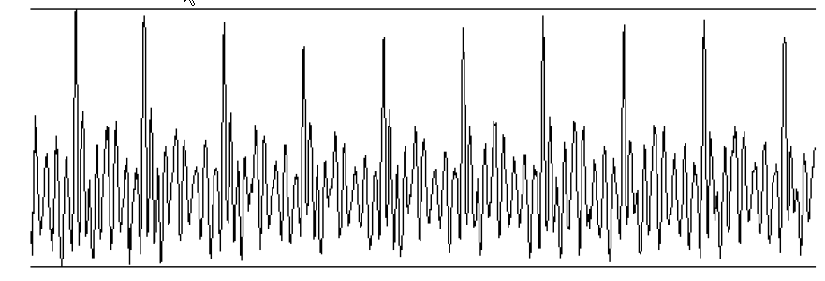
Speech signal
Voiced Excitation → fundamental frequency
(Speaker dependent)
Loudness → signal amplitude
Vocal tract shape → spectral shaping
(most important to recognize words)
A time signal of vowel /a:/
(fs=11 kHz, length=100ms)
time

Slide 6
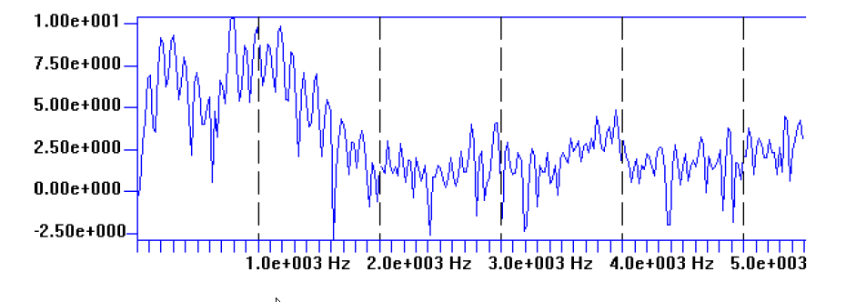
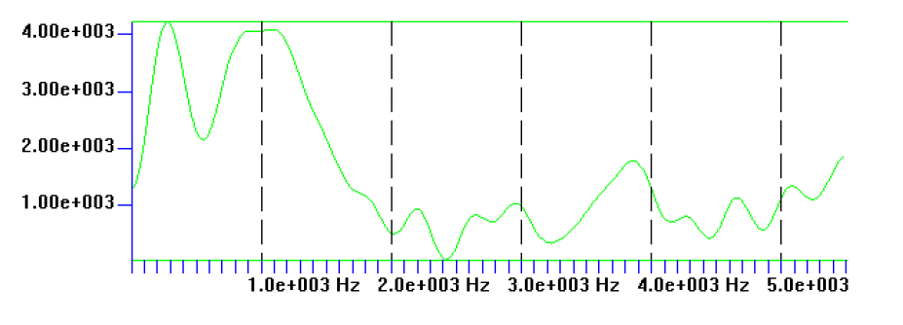
ACOUSTIC PRE-PROCESSING
DFT (Discrete Fourier Transform) → Spectral Coeff.
Inverse DFT on log power spectrum → Cepstral Coeff.
Makes it easier to extract spectral shaping of the speech signal.
Log power spectrum of vowel /a:/
(fs=11 kHz, N=512)
frequency
Power spectrum of the vowel /a:/ after cepstral smoothing

Slide 7
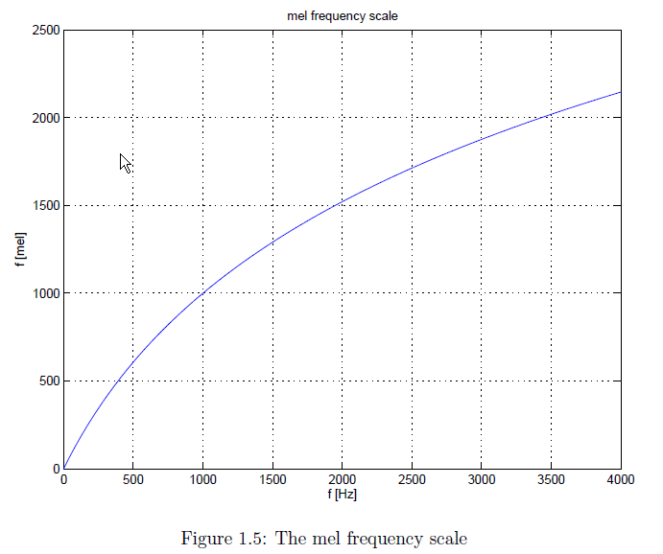
MFCC (Mel frequency cepstral coefficients)
Mel frequency scale reflects frequency resolution of human ear.
Coeff. Of power spectrum → Mel Spectral Coeff. (FEATURE VECTOR)

Slide 8
RECOGNIZER
One word spoken contains dozens of feature vectors. (preprocessing every 10 ms of signal)
Compute a ”distance” between this unknown sequence of vectors (unknown word) and known sequence of vectors (prototypes of words to recognize)
PROBLEM !! Unequal length of vector sequence

Slide 9
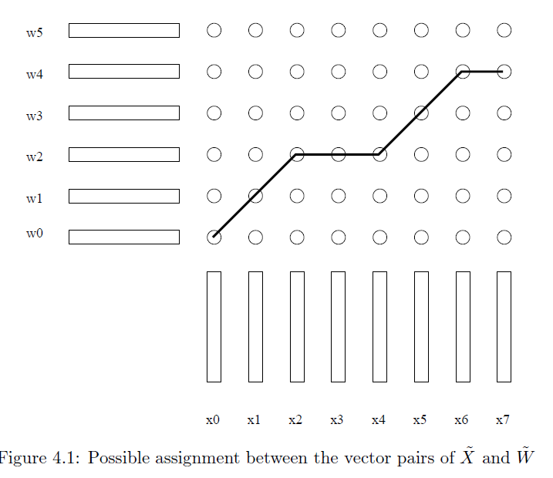
Dynamic time warping : Find optimal assignment path

Slide 10
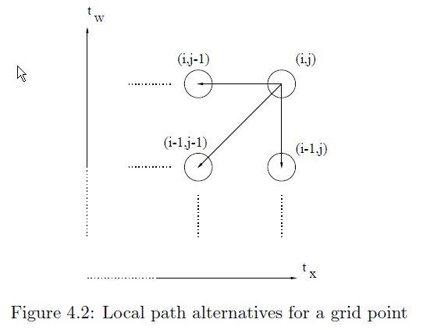
Dynamic time warping : Find optimal assignment path

Slide 11
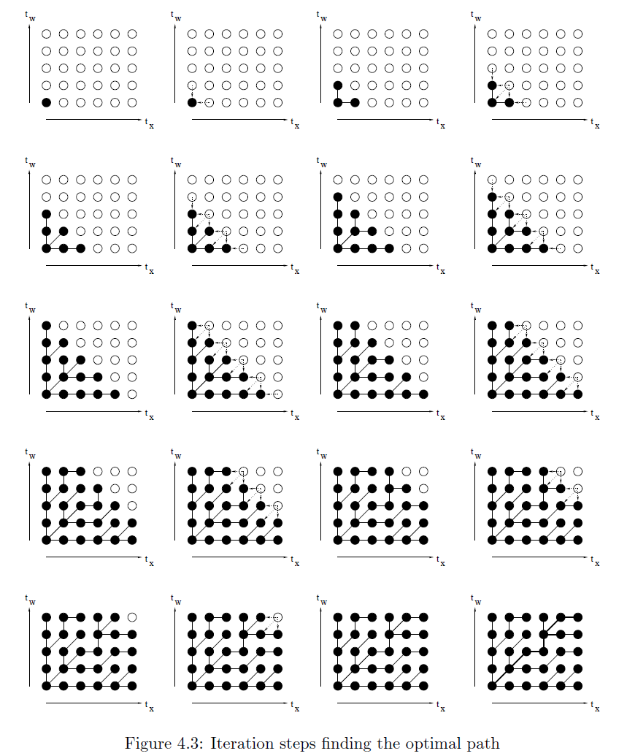
Dynamic time warping : Find optimal assignment path

Slide 12
DTW : Recognizing connected words

Slide 13
MATLAB FUNCTIONS
PRE-PROCESSING
recordMelMatrix(3)
S = wavread(“speech.wav”)
C = Melfiltermatrix(S, N, K)
computeMelSpectrum( C,S);
DISPLAY FEATURES
Featuredisp.m
WORD RECOGNITION
dp_asym(vector1, vector2)

Slide 14
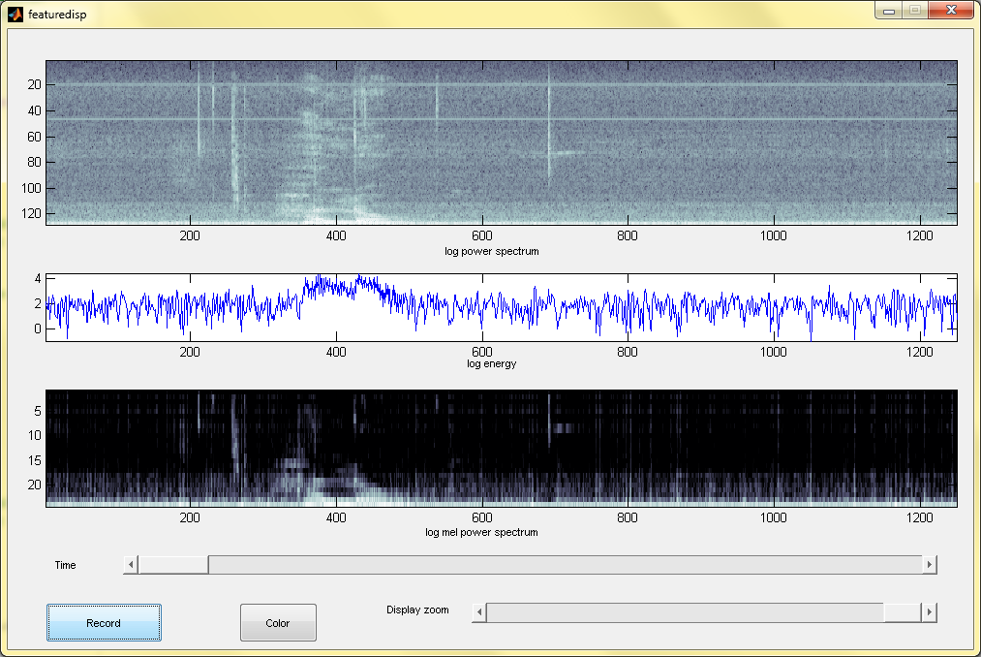
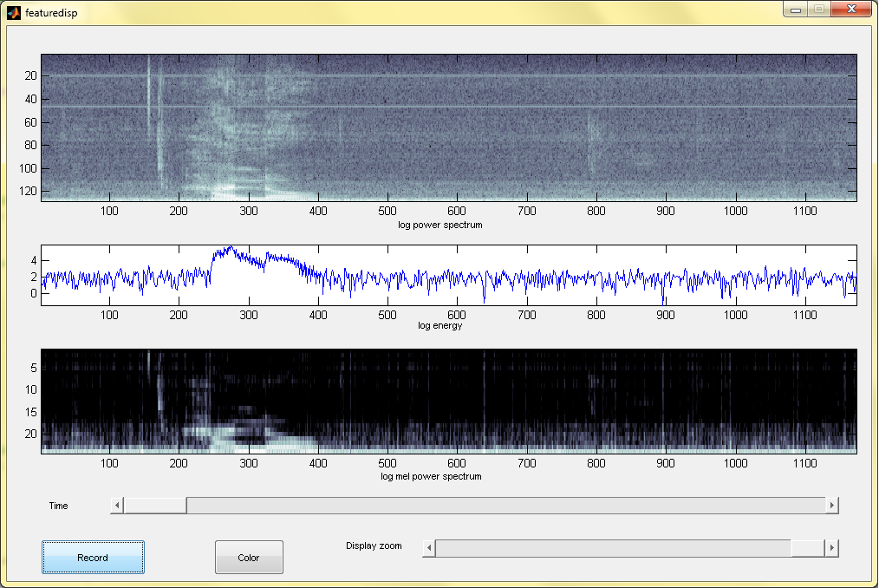
Results
hello
hello1

Slide 15
hello
library

Slide 16
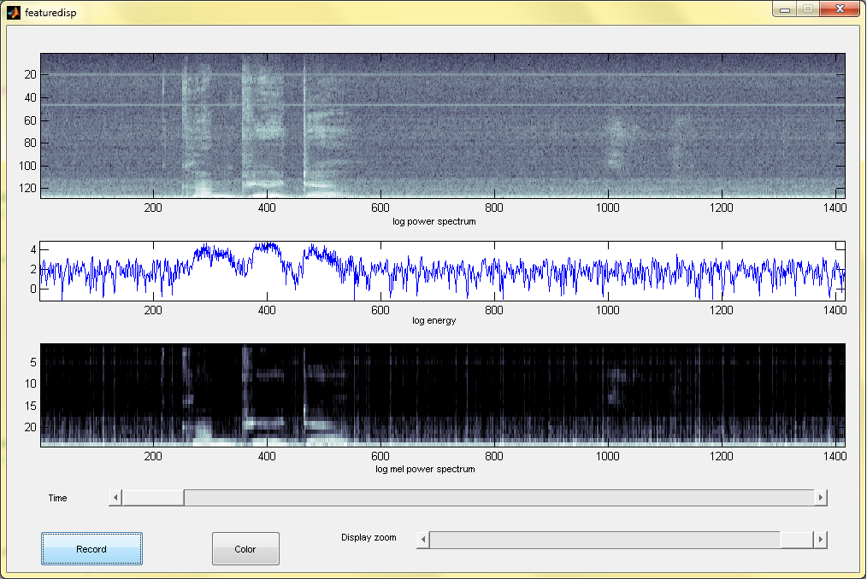
hello
computer

Slide 17
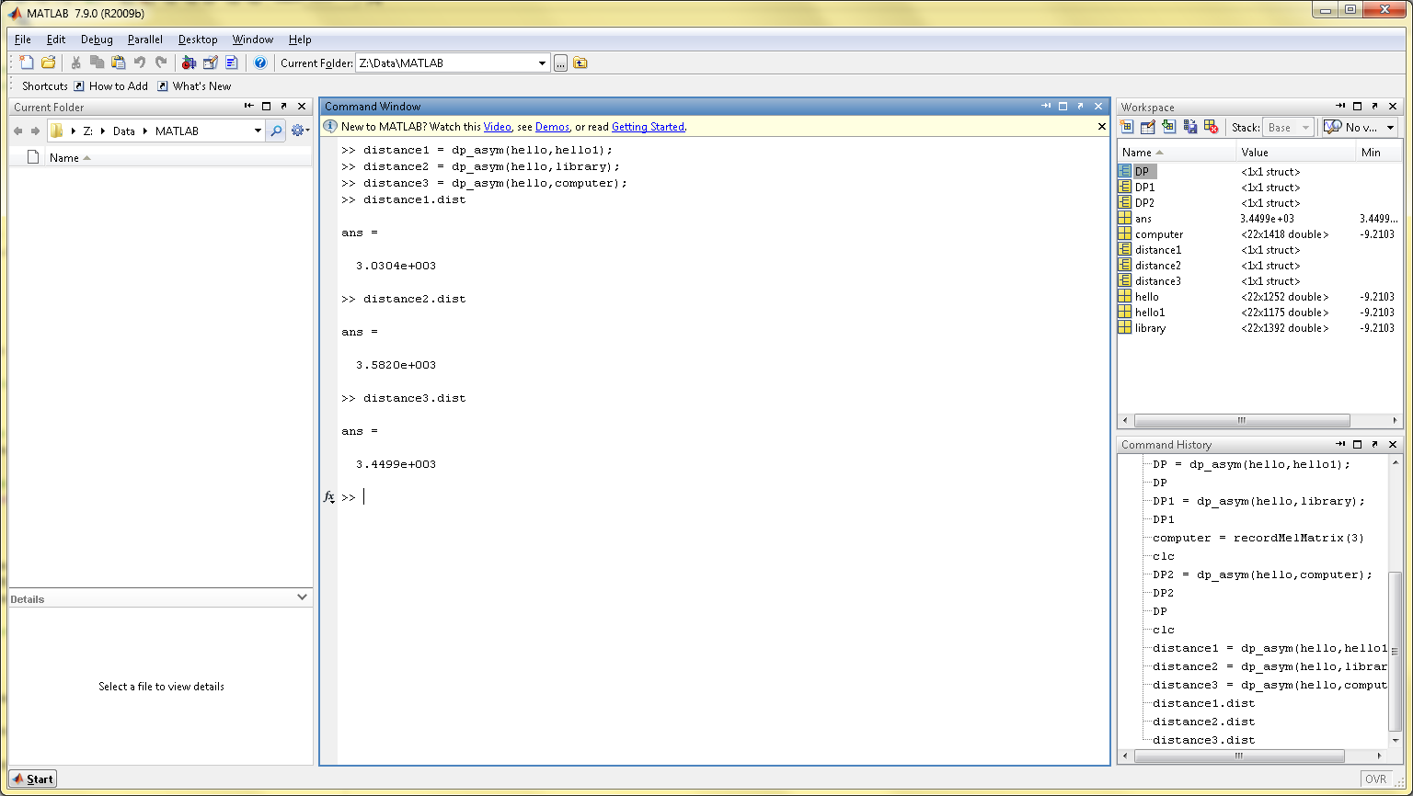
3.0304e+003
3.5820e+003
3.4499e+003

Slide 18
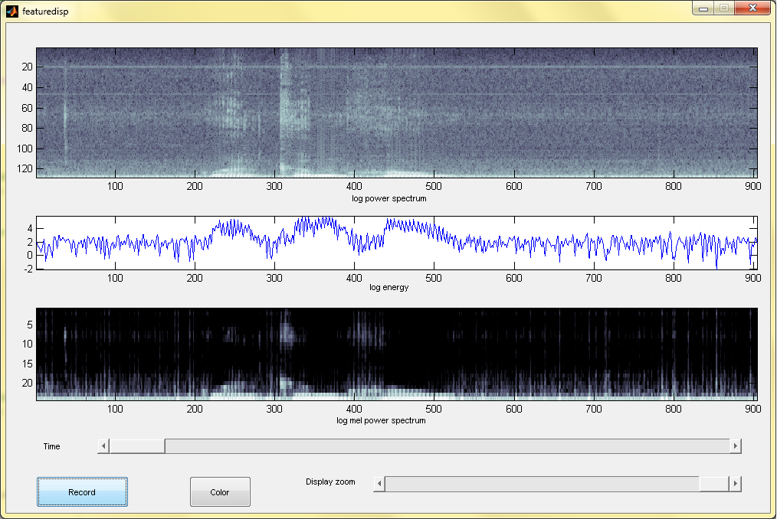
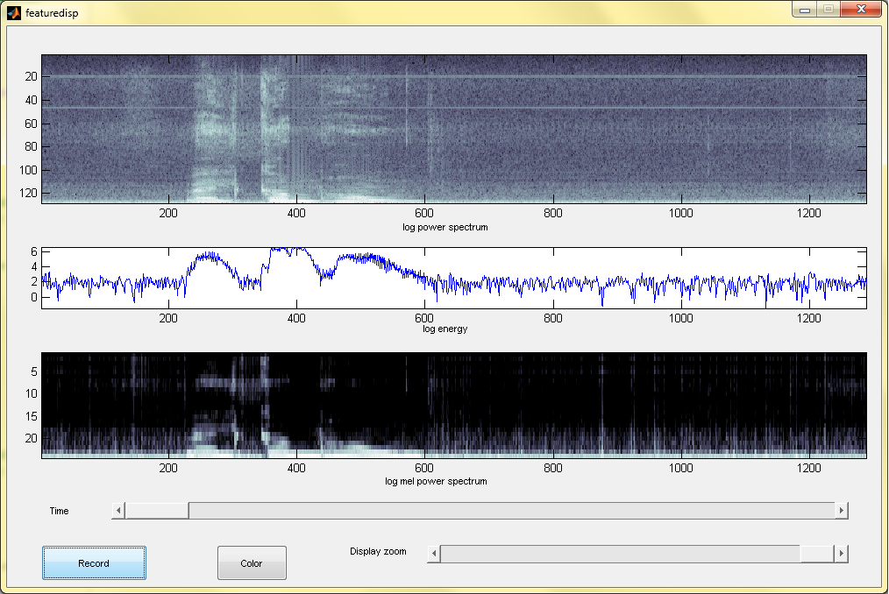
Welcome home (male)
Welcome home (female)

Slide 19
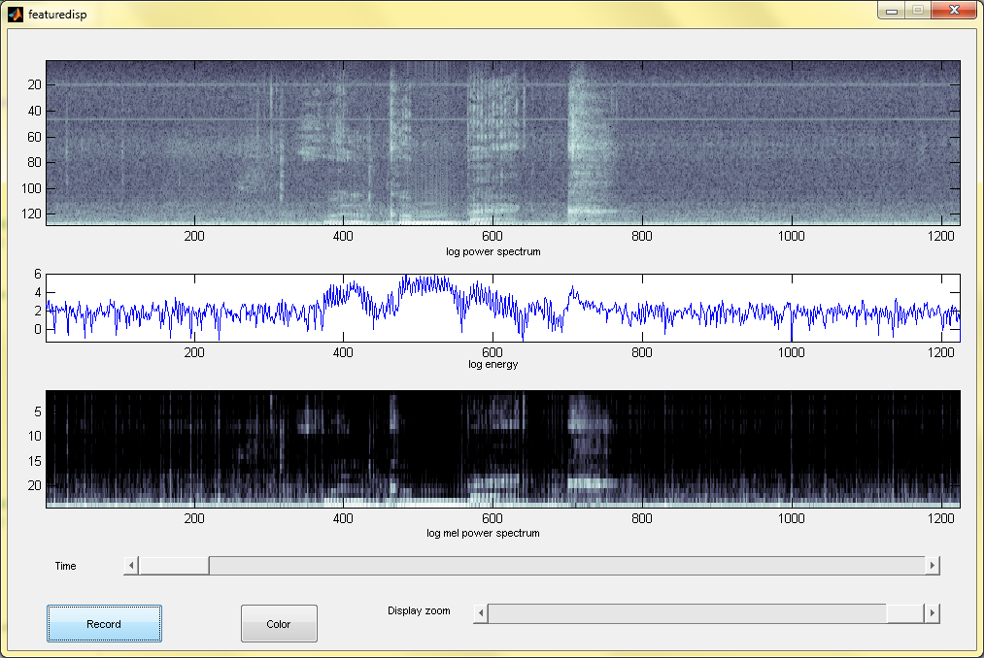
Welcome home
Welcome back

Slide 20
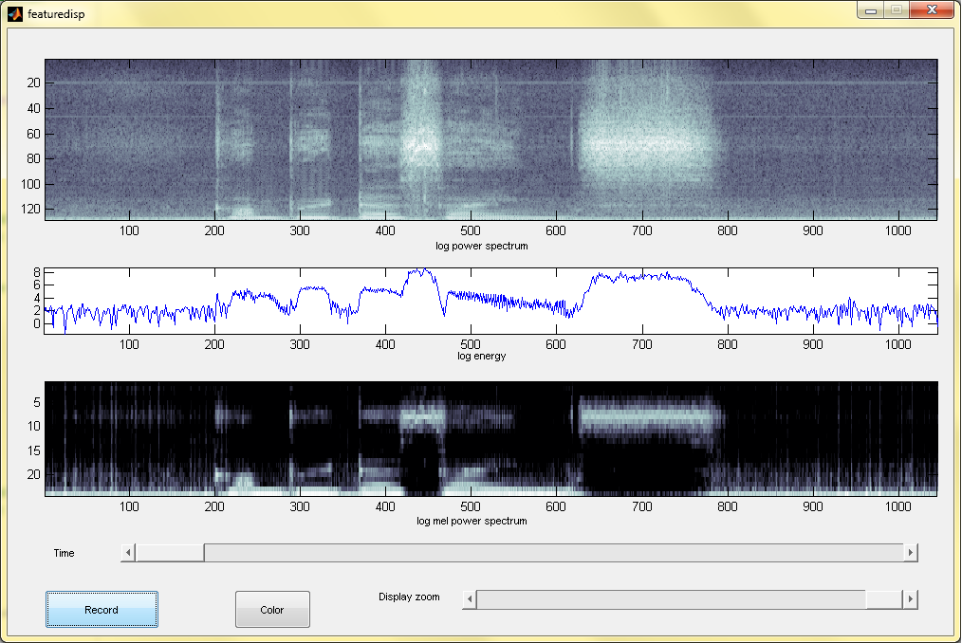
Welcome home
Computer Science

Slide 21
Welcome back
Computer Science

Slide 22
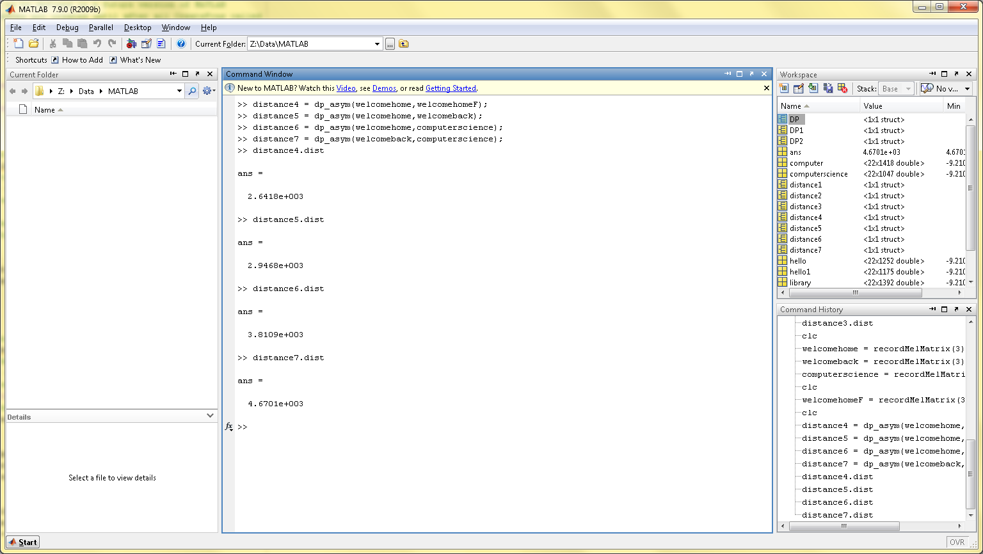
2.6418e+003
2.9468e+003
3.8109e+003
4.6701e+003

Slide 23
THANKS !
ANY QUESTIONS?

